Slide 1
Transfer to Home Delivery / Pharmacy Options
express-scripts.com
2019

Slide 2
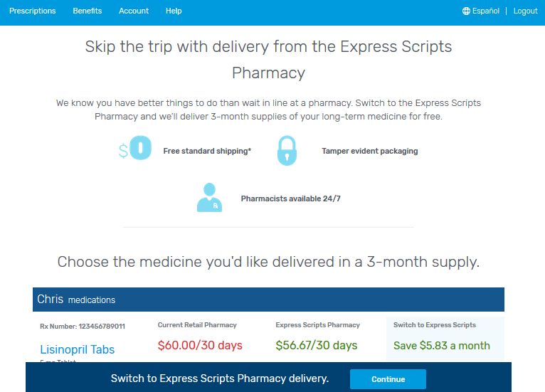
Pharmacy Options
A one-stop shop for members to view their savings opportunities based on their prescription needs and plan design
Includes pharmacy options supporting:
Transfer to Home Delivery
Smart 90–Active Choice
Smart 90–Incentive Choice

Slide 3
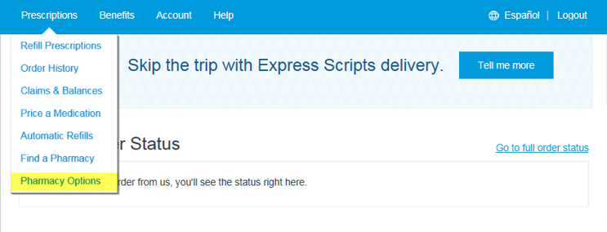
Accessing Pharmacy Options
Upon login, members will be presented with a banner when cost or convenience savings opportunities exist
To view details members can:
Click the opportunity banner¹, or
Select Pharmacy Options from the main menu, or
Use the link in the new messaging in the Transfer to Home Delivery section
1
2
1
¹ A banner will not display for Med D members. They access pharmacy options using the other options.
3

Slide 4
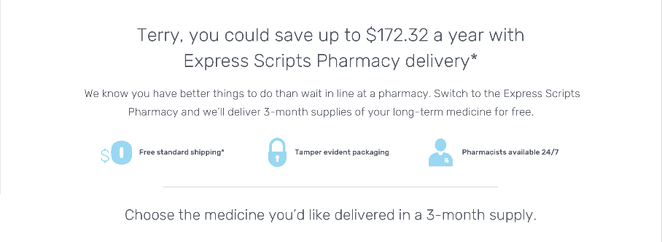
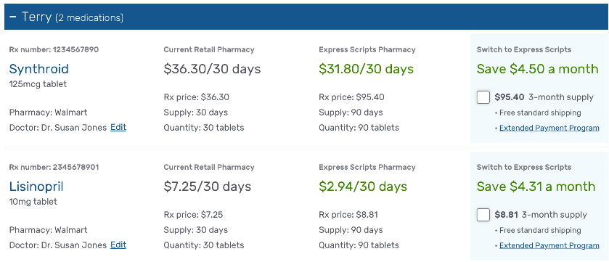
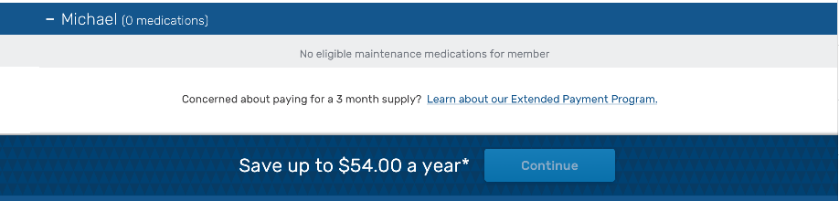
Savings Opportunities
Savings are clearly presented for each eligible prescription in the household (Household View permissions apply)
30 and 90-day pricing is provided, with easy comparison at 30 days supply (days supply may vary)
Member checks medicines they wish to transfer
Note: This is for illustration purposes only; numbers do not necessarily align throughout this page

