Slide 1
Express Scripts Mobile App
Client Presentation
2019

Slide 2
Delivering an “easy” member experience
Digital focus
Through simple,
empowering
digital experiences
“Today was the first time I reordered a script via the member shortcuts; they are awesome easy … thank you.” - Current Member
#1 in Overall Satisfaction for PBMs with more than 20M members
Tied for first in member satisfaction for “website for members”
* 2018 PBMI PBM Customer Satisfaction Report
© 2019 Express Scripts. All Rights Reserved.

Slide 3
Better decisions & healthier outcomes – on the go with the Express Scripts mobile app
Convenience
Easy-order refills and up-to-the-minute order status lets members avoid trips to their local pharmacy
Simplicity
One swipe of the finger is all it takes to stay on track with medications
Peace of Mind
Reminders and a drug interaction checker help keep members traveling on the road to good health
Versatility
Flexibility that fits members’ lives, delivering personalized information – whenever & wherever they need it
© 2019 Express Scripts. All Rights Reserved.
Notes:
The Express Scripts mobile app provides clear, simple functionality enabling members to instantly access their personalized medication information. In fact, mobile app usage results in better drug therapy adherence, reduced waste and fewer doctor visits – leading to savings for both our clients and members.
Please note:
Features available are based on the member’s plan design and mirrors the member website experience.
The Express Scripts mobile app is not available for private label clients members.
See express-scripts.com/MobileApp for supported platforms, app stores, and devices.

Slide 4
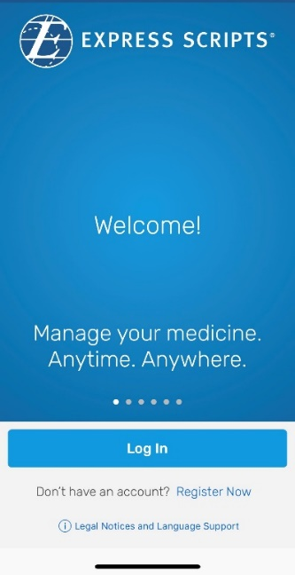
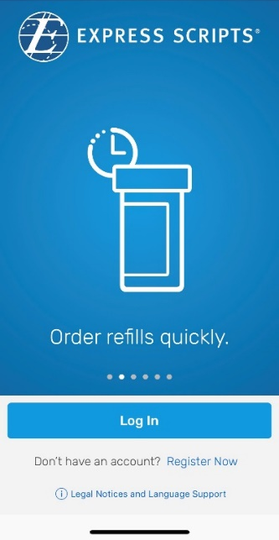
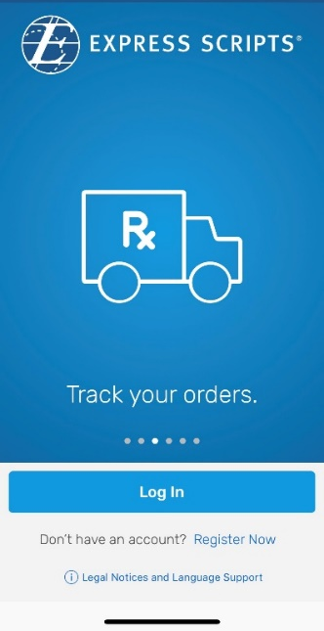
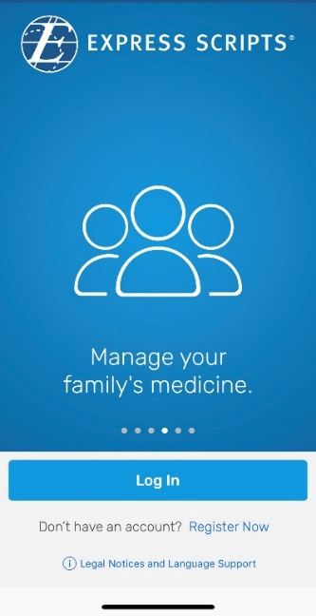
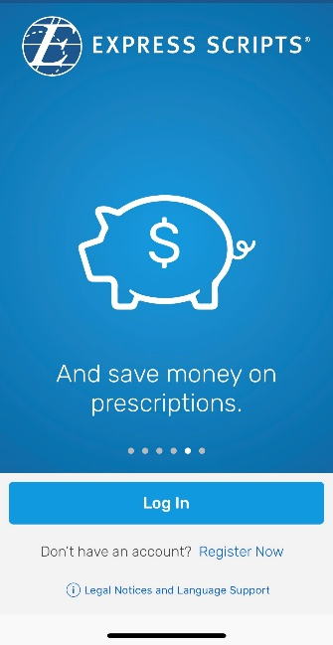
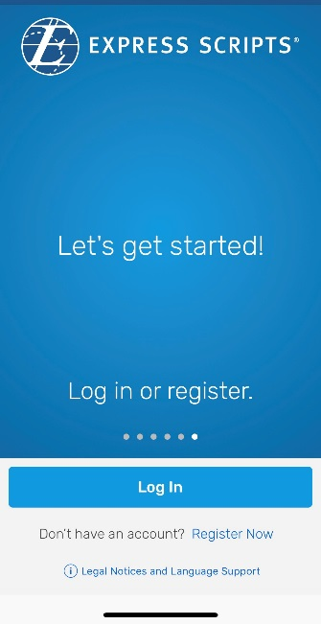
What’s New? Tour
Convenience & simplicity
First-time optional tour of new features
© 2019 Express Scripts. All Rights Reserved.
Notes:
Tour / Overview of features
Members can review new features or log in/register at any time.
Only appears the first-time member logs in after updates.

Slide 5
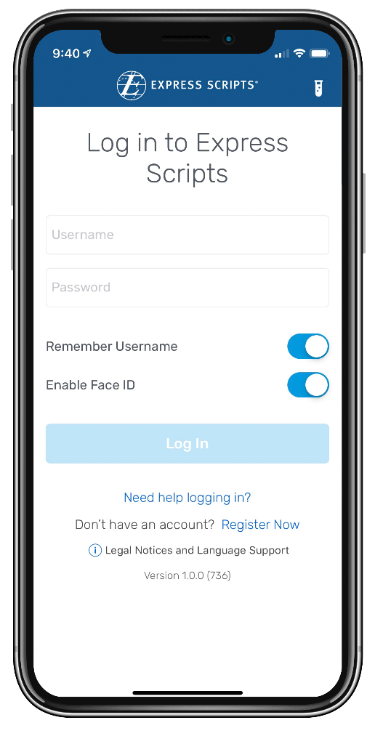
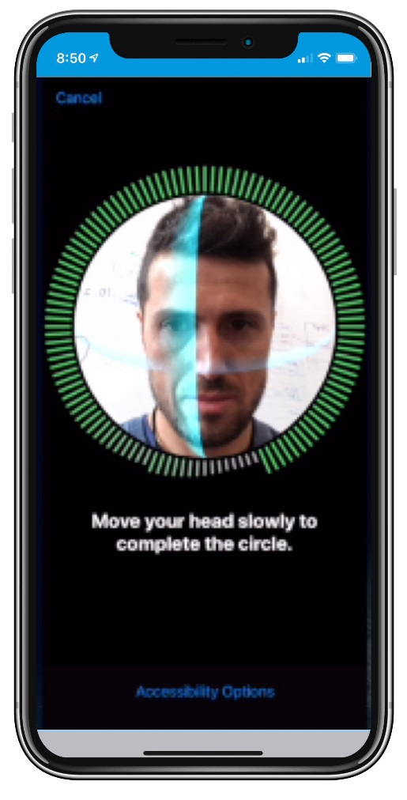
Register or Login
Convenience & simplicity
Biometric authentication
Face ID
© 2019 Express Scripts. All Rights Reserved.
Notes:
Biometric authentication – touch or facial recognition, as available on the member’s device.

Slide 6
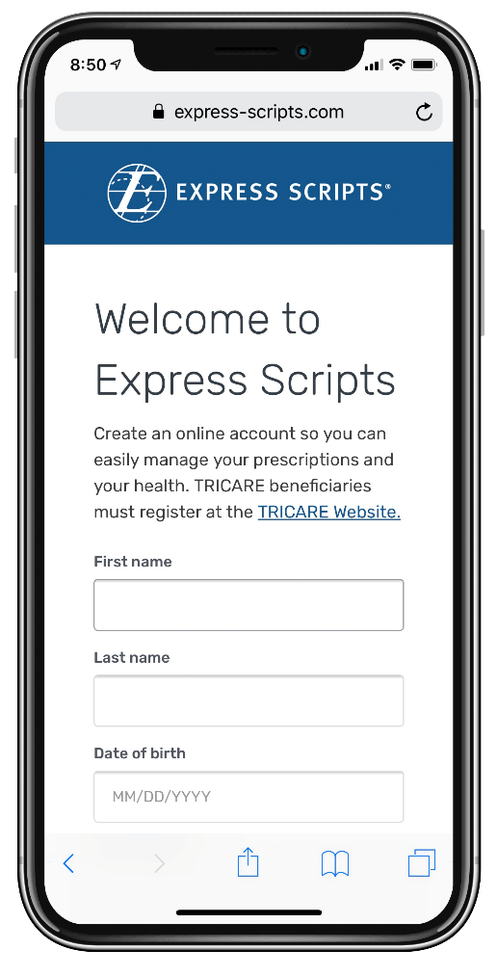
Register
Convenience & simplicity
First-time visitors register and authenticate by entering member ID number or Social Security Number (SSN)
© 2019 Express Scripts. All Rights Reserved.
Notes:
Registration
Members can register in the app and immediately begin using all of its features – and use the same username and password to access the express-scripts.com member website
After first-time registration, members can set-up touch ID or face ID access for future visits

Slide 7
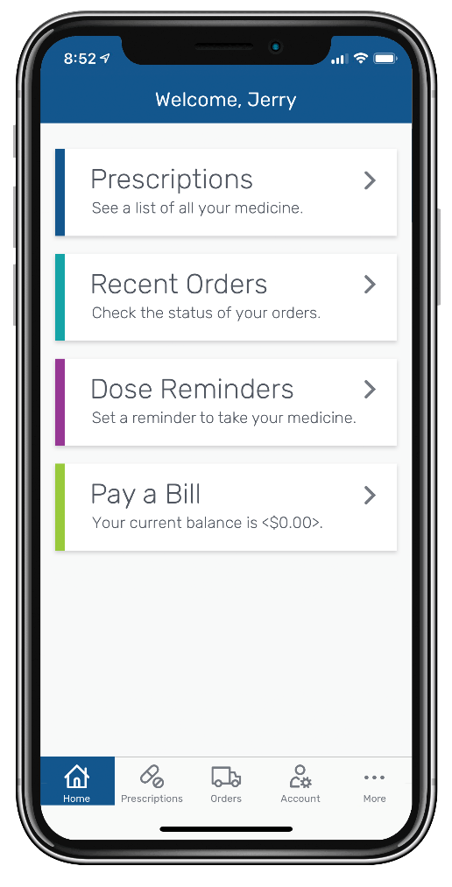
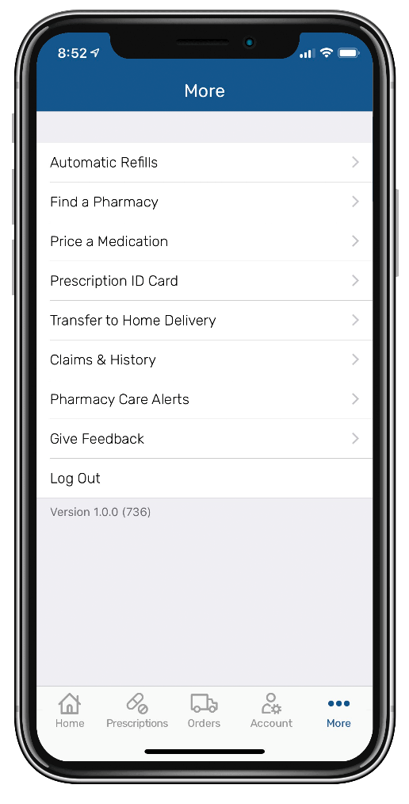
Dashboard
Convenience & simplicity
Quick access to popular actions and easy access to the full menu
© 2019 Express Scripts. All Rights Reserved.
Notes:
Dashboard
Members can quickly and easily refill and renew home delivery prescriptions
Not available to members of Retail-only clients

Slide 8
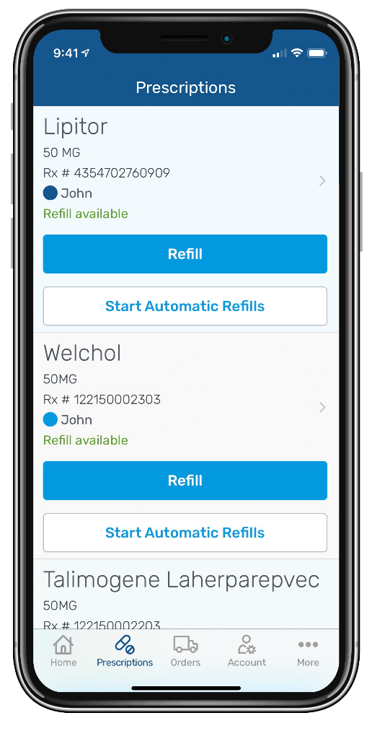
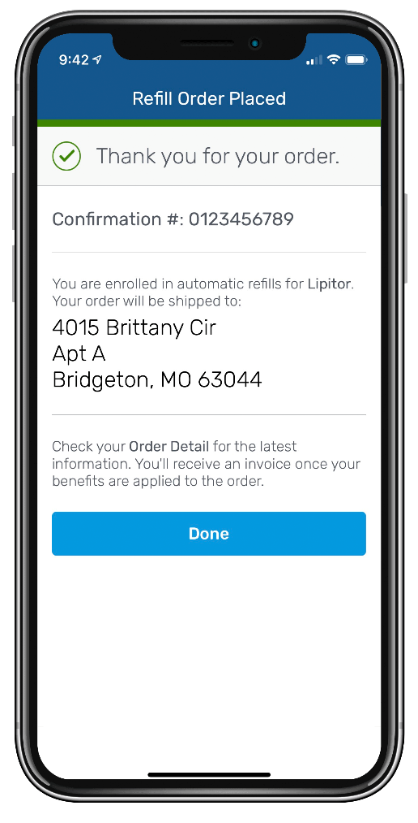
Refill & Renew
Convenience & simplicity
Two-tap refill process
© 2019 Express Scripts. All Rights Reserved.
Notes:
Refills and Renewals
Members can quickly and easily refill and renew home delivery prescriptions
Not available to members of Retail-only clients

Slide 9
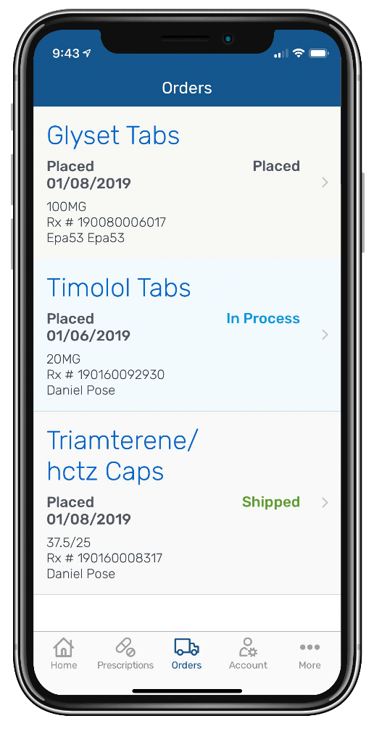
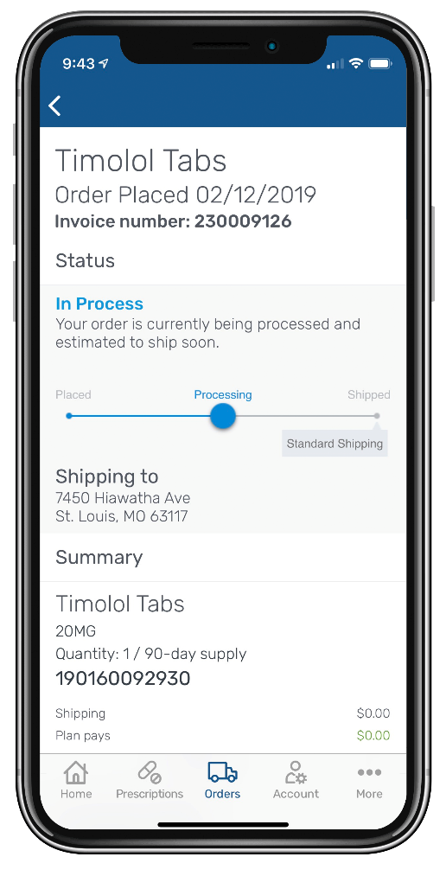
Order Status
Convenience & simplicity
Easily track orders to the door
© 2019 Express Scripts. All Rights Reserved.
Notes:
Order Status
Members can track the status of home delivery prescription orders
Not available to members of Retail-only clients

Slide 10
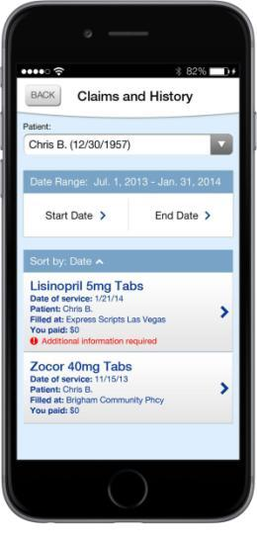
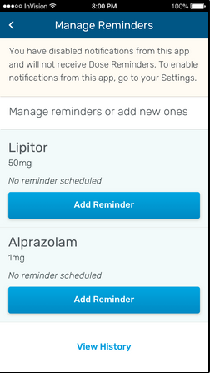
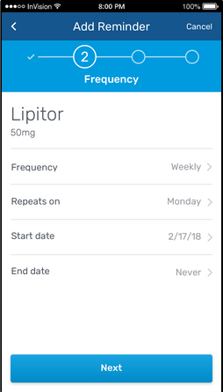
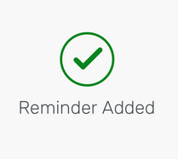
Dose Reminders
Peace of mind & versatility
Easy step-by-step instructions accommodate multiple medicines
© 2019 Express Scripts. All Rights Reserved.
Notes:
Dose Reminders
Members can easily manage multiple prescriptions with reminder alerts that can be set up to notify when it’s time to take medications.

Slide 11
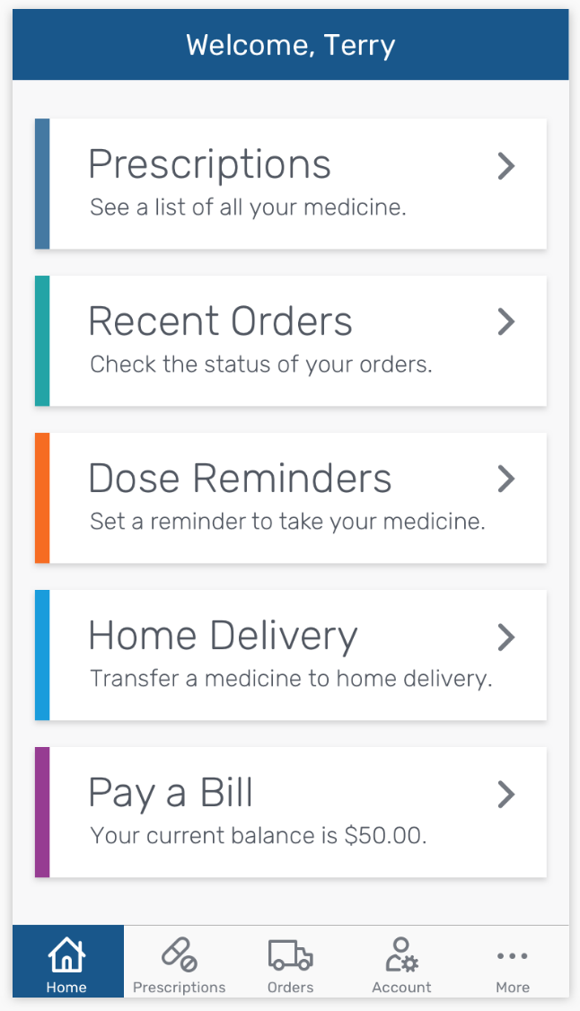
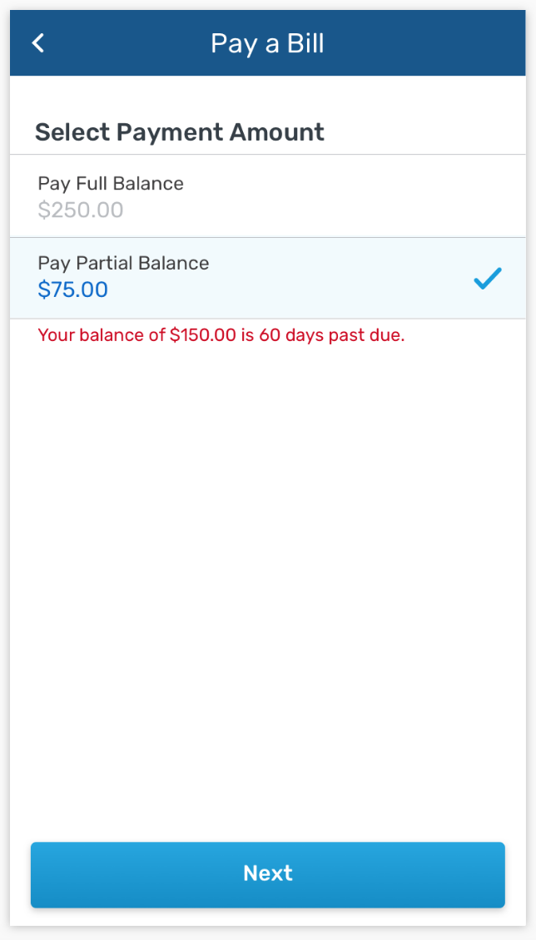
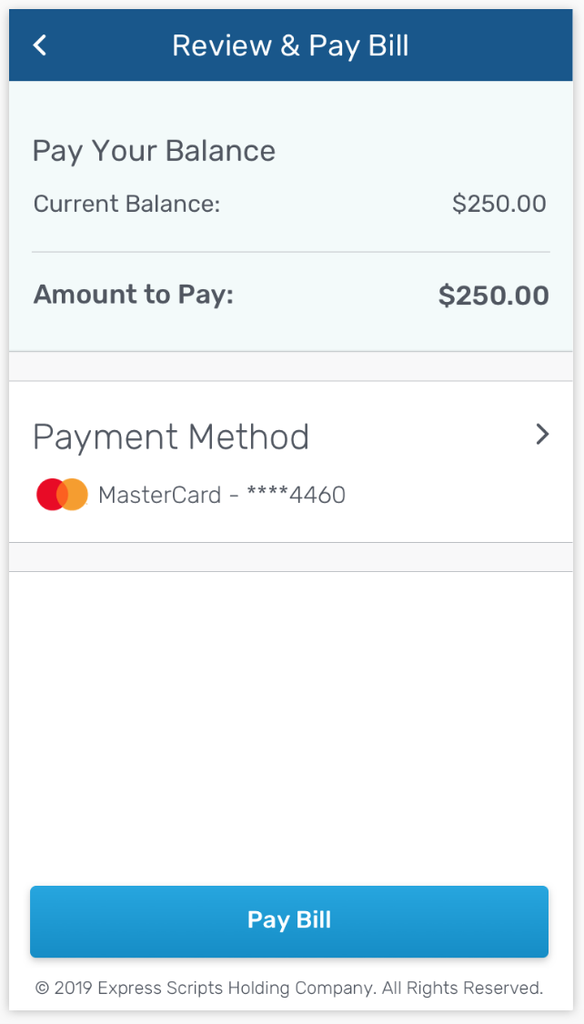
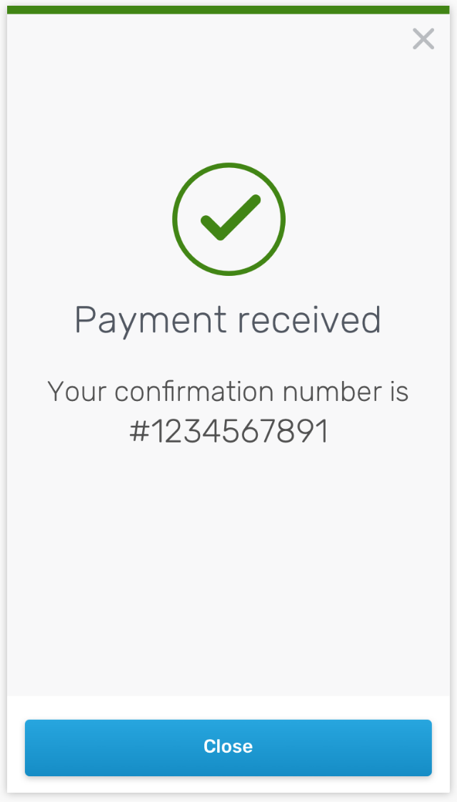
Pay a Bill
Convenience & simplicity
Subject to change

Slide 12
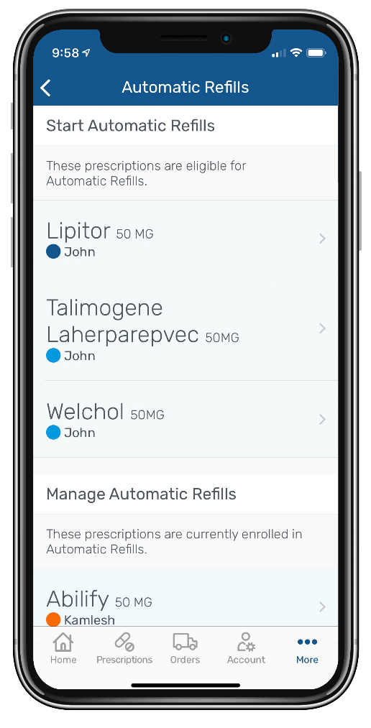
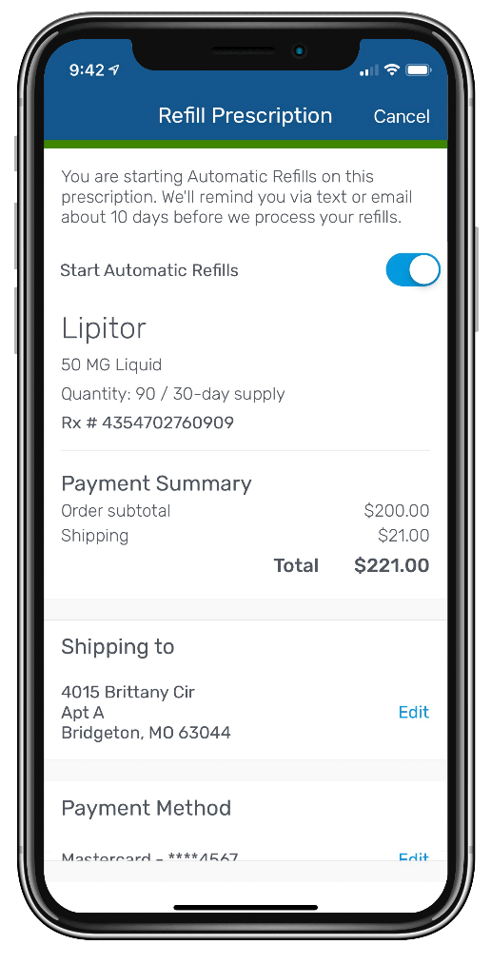
Automatic Refills
Convenience & simplicity
Home Delivery members can enroll eligible prescriptions in automatic refills
Auto refills can help to ensure members always have their medicines when they need them
© 2019 Express Scripts. All Rights Reserved.
Notes:
Manage Automatic Refills
For eligible medications taken on a regular basis, members can start automatic refills
They can start/stop or change refill dates as needed

Slide 13
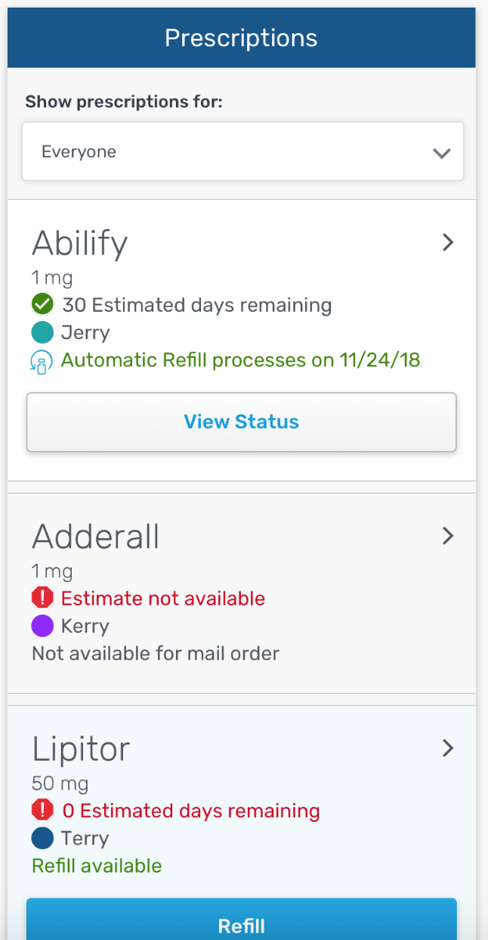
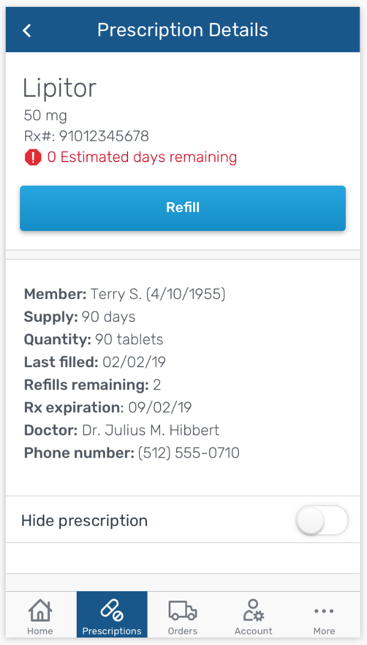
Days supply indicator
Convenience & simplicity
Days supply indicator added allowing members to see the estimated days remaining of their existing prescription
This enhancement was made based on direct member feedback we received from app users
Subject to change

Slide 14
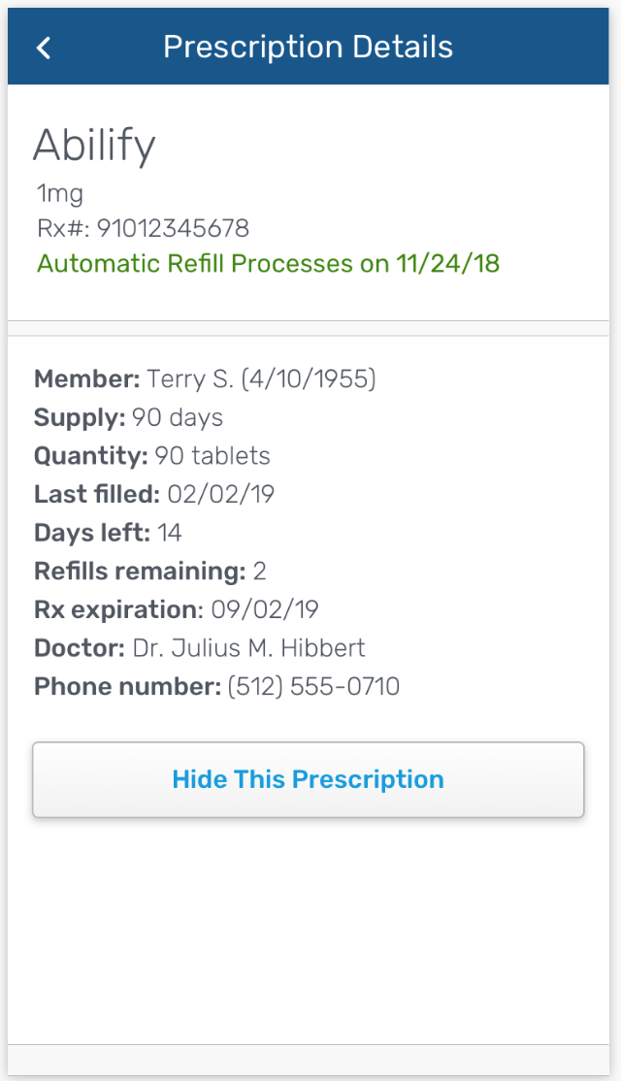
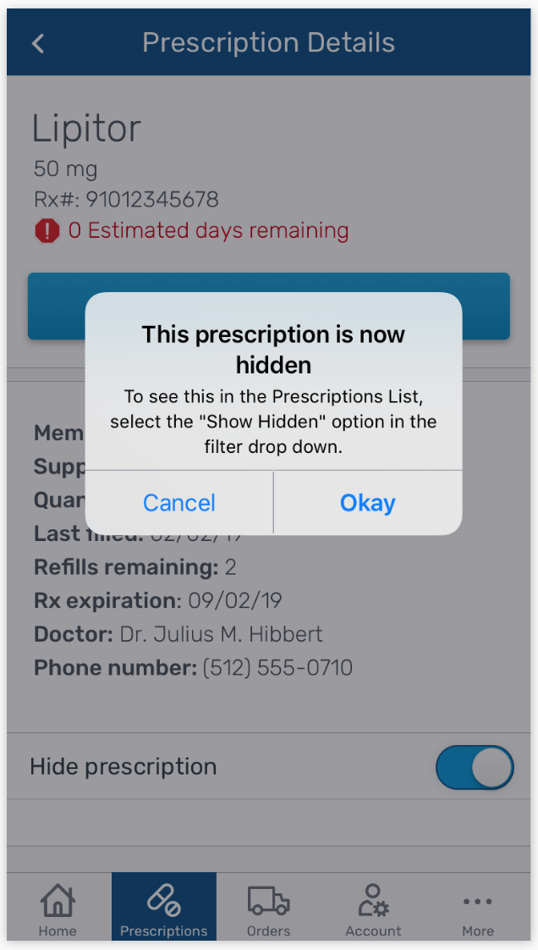
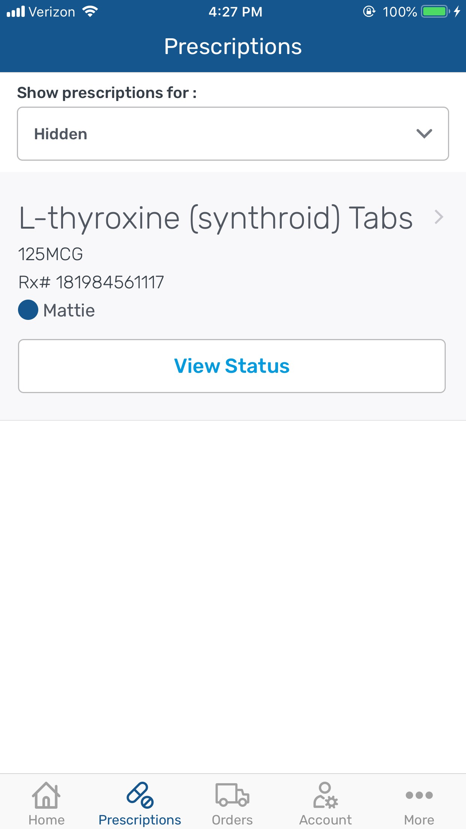
Ability to hide a prescription
Convenience & simplicity
Members can hide prescriptions they do not want to see
And quickly see them again by selecting to show hidden prescriptions
Subject to change

Slide 15
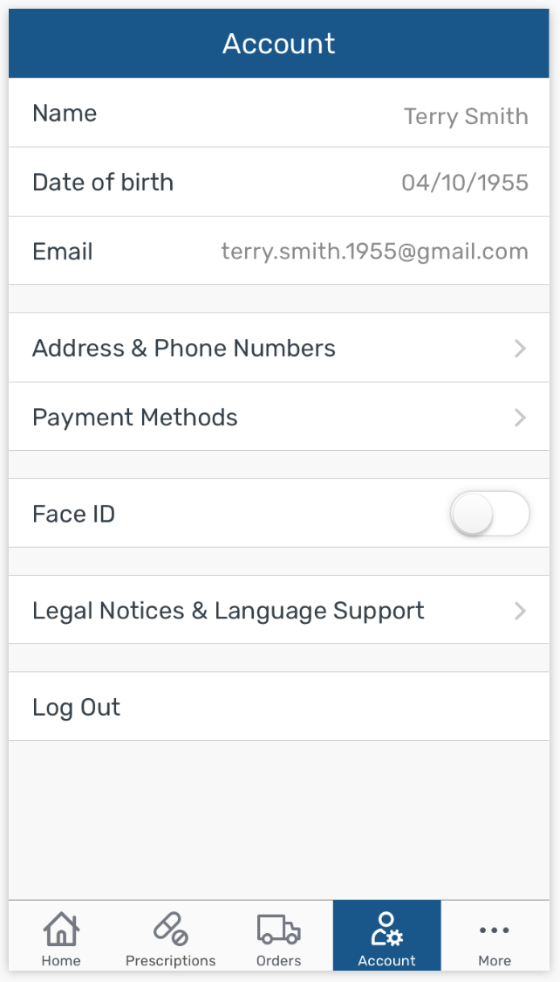
Account – Update address & payment information
Convenience & simplicity
Members have more information stored in the app account
Subject to change

Slide 16
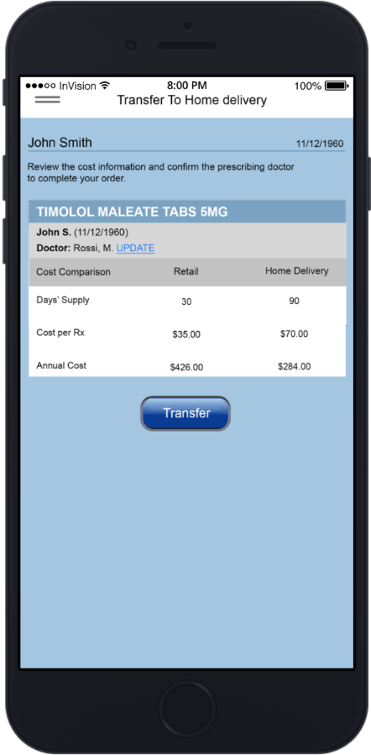
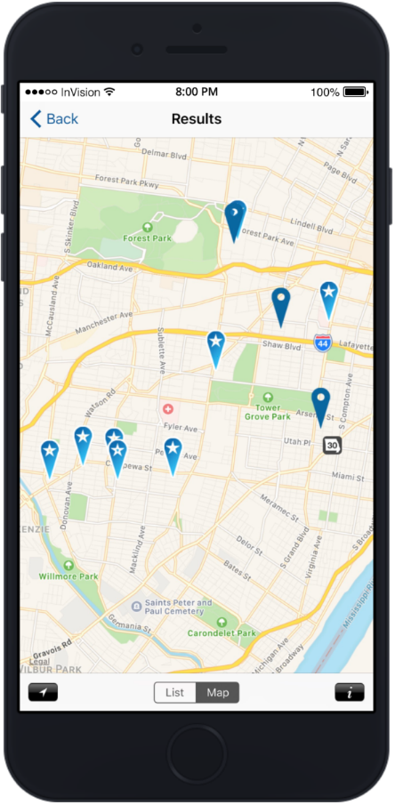
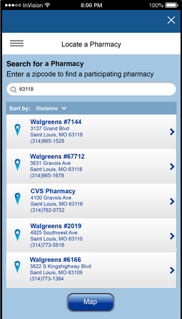
Pharmacy Options Find a Pharmacy
Convenience & simplicity
Find nearby in-network pharmacies and access driving directions
© 2019 Express Scripts. All Rights Reserved.
Notes:
Find a Pharmacy/Pharmacy Options
Find convenient in-network pharmacies based on your ZIP code or current location
Helpful when travelling

Slide 17
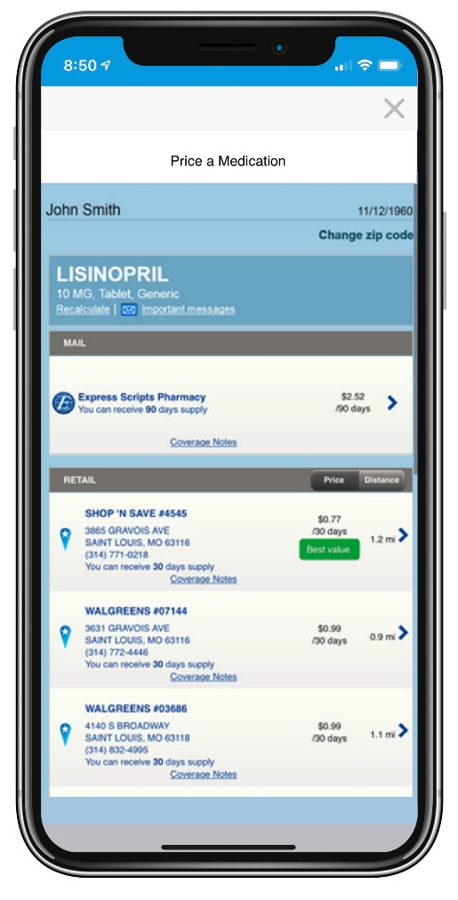
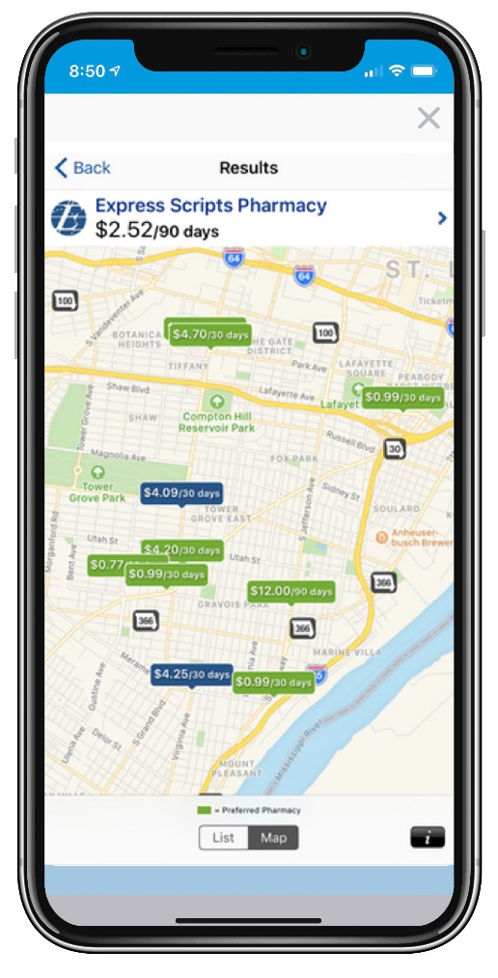
Price a Medication
Convenience & simplicity
Pricing and coverage information
@ home delivery @ retail pharmacies
© 2019 Express Scripts. All Rights Reserved.
Notes:
Price a Medication (aka Retail Pricing Transparency)
Check drug prices and confirm coverage with your plan while in your doctor’s office
Compare drug prices for home delivery and multiple local retail pharmacies
View results in a list and in a map display

Slide 18
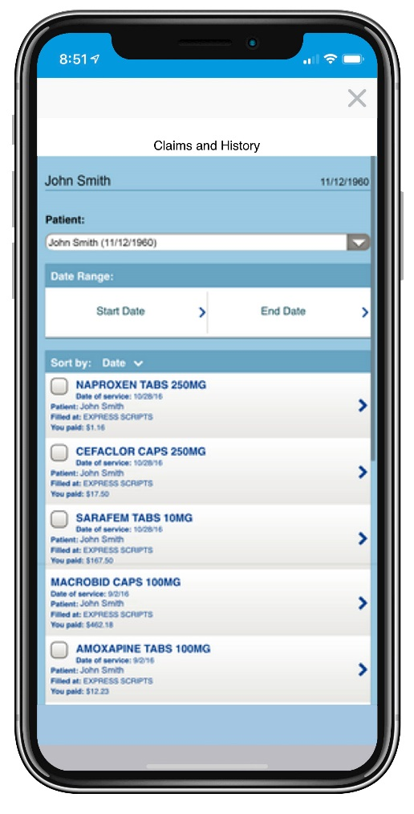
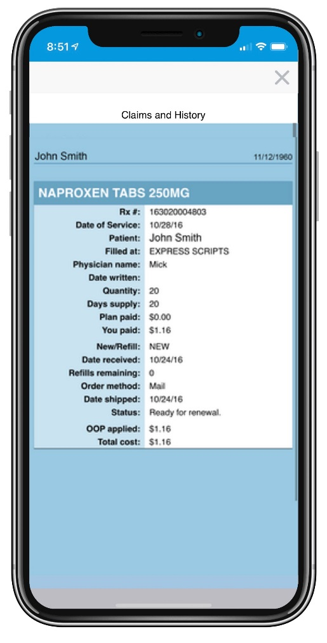
Claims and History
Convenience & simplicity
View prescription history and payment information
© 2019 Express Scripts. All Rights Reserved.
Notes:
Claims and History
Members can view their past prescription activity and payment details

Slide 19
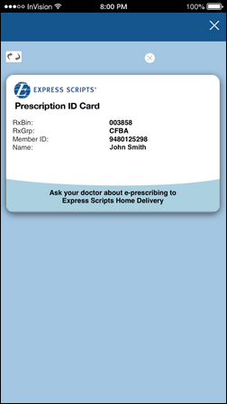
Member ID Card
Convenience & simplicity
Two-sided virtual ID card goes where the member goes
© 2019 Express Scripts. All Rights Reserved.
Notes:
Virtual ID Card
Members can access their member ID card conveniently and immediately – one less card to carry

Slide 20
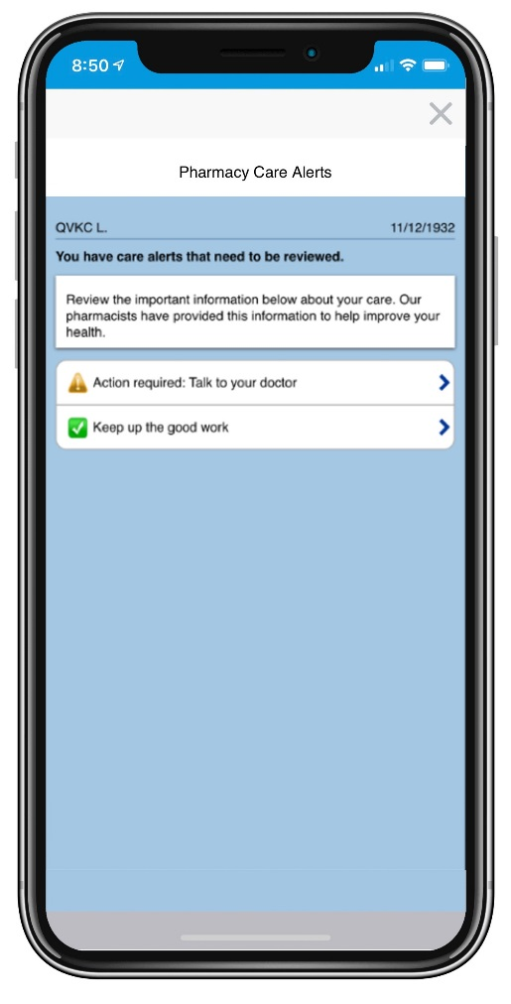
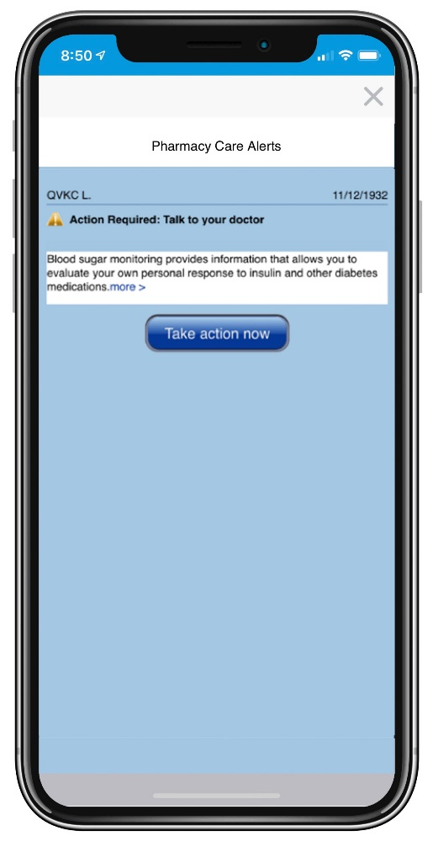
Pharmacy Care Alerts
Peace of mind & versatility
Easy step-by-step instructions accommodate multiple medicines
© 2019 Express Scripts. All Rights Reserved.
Notes:
Pharmacy Care Alerts
Members can review their personalized alerts to help ensure they are following treatment plans as prescribed by their physician and closing any gaps in care
Alerts are displayed for adherence, omission, and compliance reasons
Members are able to take informed, immediate action to address any open alerts

Slide 21
Supported Platforms, App Stores, Devices
overview
 | iPhone® 4 series and later, iPad®
 | Android devices running OS 4.0+
iOS
(iTunes)
Android
(Google Play)
© 2019 Express Scripts. All Rights Reserved.
Notes:
App is available for Medicare Part D members (since 1/1/15)
App is not available for private label clients.

Slide 22
© 2019 Express Scripts. All Rights Reserved.

